Slide 1
ReturnGuard
An Intelligent, COD-Native Risk Defense System for Indian D2C Commerce
Mentor Name: Thavayee

Slide 2
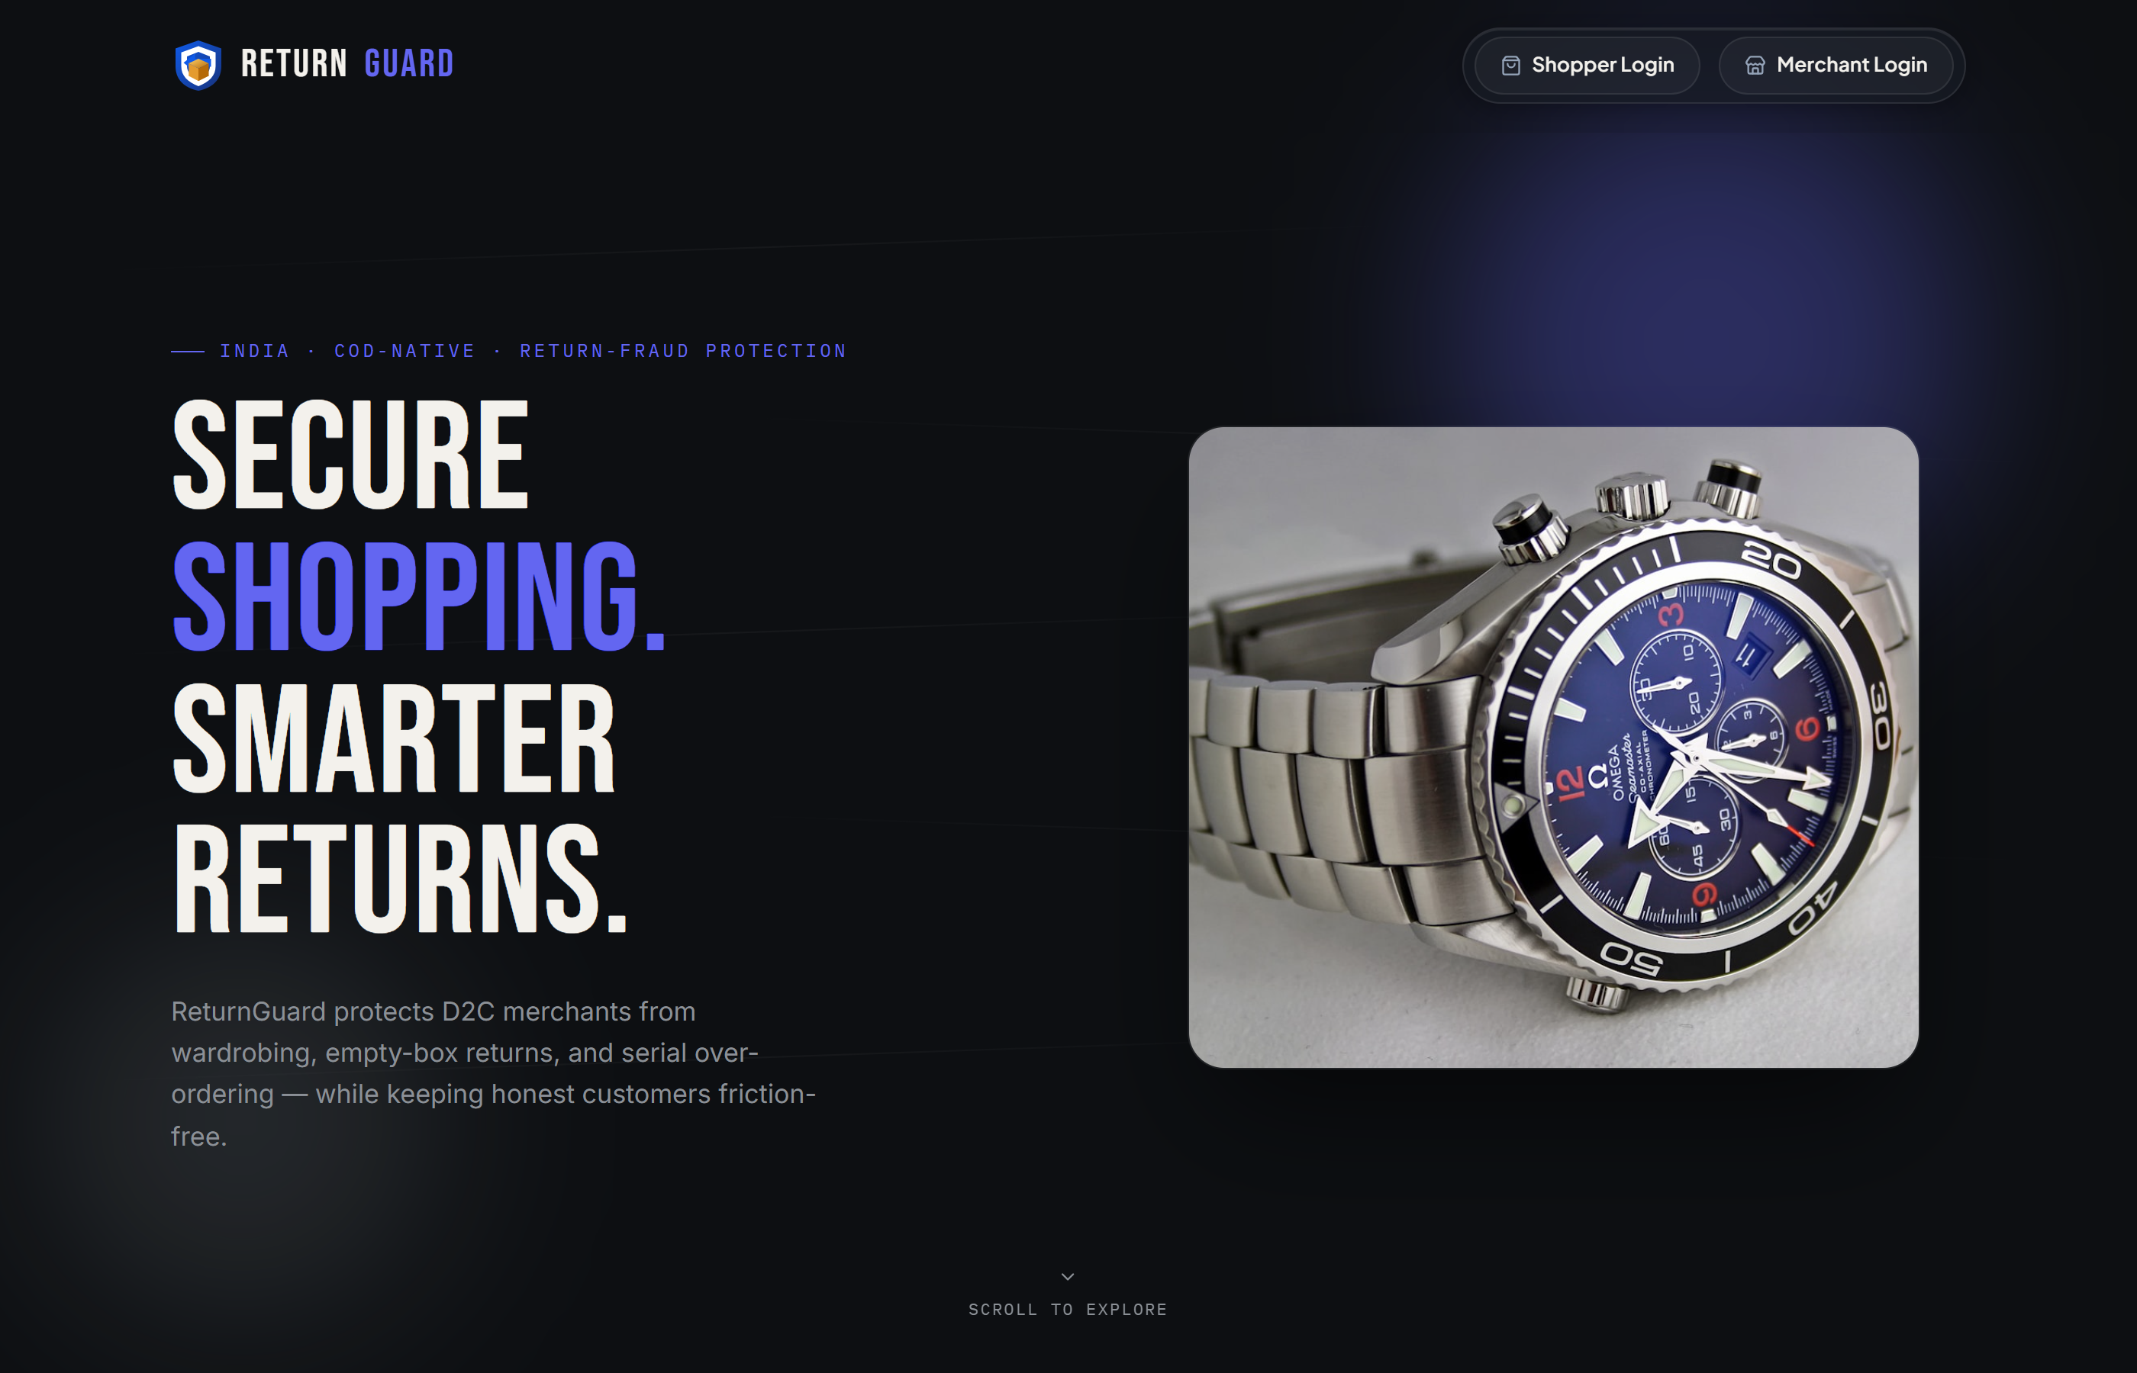
PROJECT OVERVIEW
• Problem Context in Indian D2C: Cash-on-Delivery (COD) represents 60%+ of Indian e-commerce orders, creating severe financial exposure where merchants pay 3x forward freight on illegitimate returns.
• Dual-Portal Ecosystem: A complete, production-ready web platform providing a customer storefront alongside an operations portal for merchant fraud investigation.
• Real-Time Risk Engine: Evaluates all incoming transactions and return claims dynamically across a 0 to 100 risk scoring spectrum in sub-second execution.
• Target Beneficiaries: Small-to-mid Indian D2C retailers ($50K–$5M ARR) selling apparel, lifestyle, and electronics who cannot afford costly enterprise fraud solutions.
• Frictionless by Default: 85%+ of genuine shoppers enjoy instant zero-friction auto-approvals; verification escalates only when specific risk anomalies trigger.
• Margin Preservation Value: Converts reverse logistics from an uncontrolled profit drain into a secure, revenue-protecting operational asset.
Live Screen: Storefront Landing Page & Shopper Commerce Experience

Slide 3
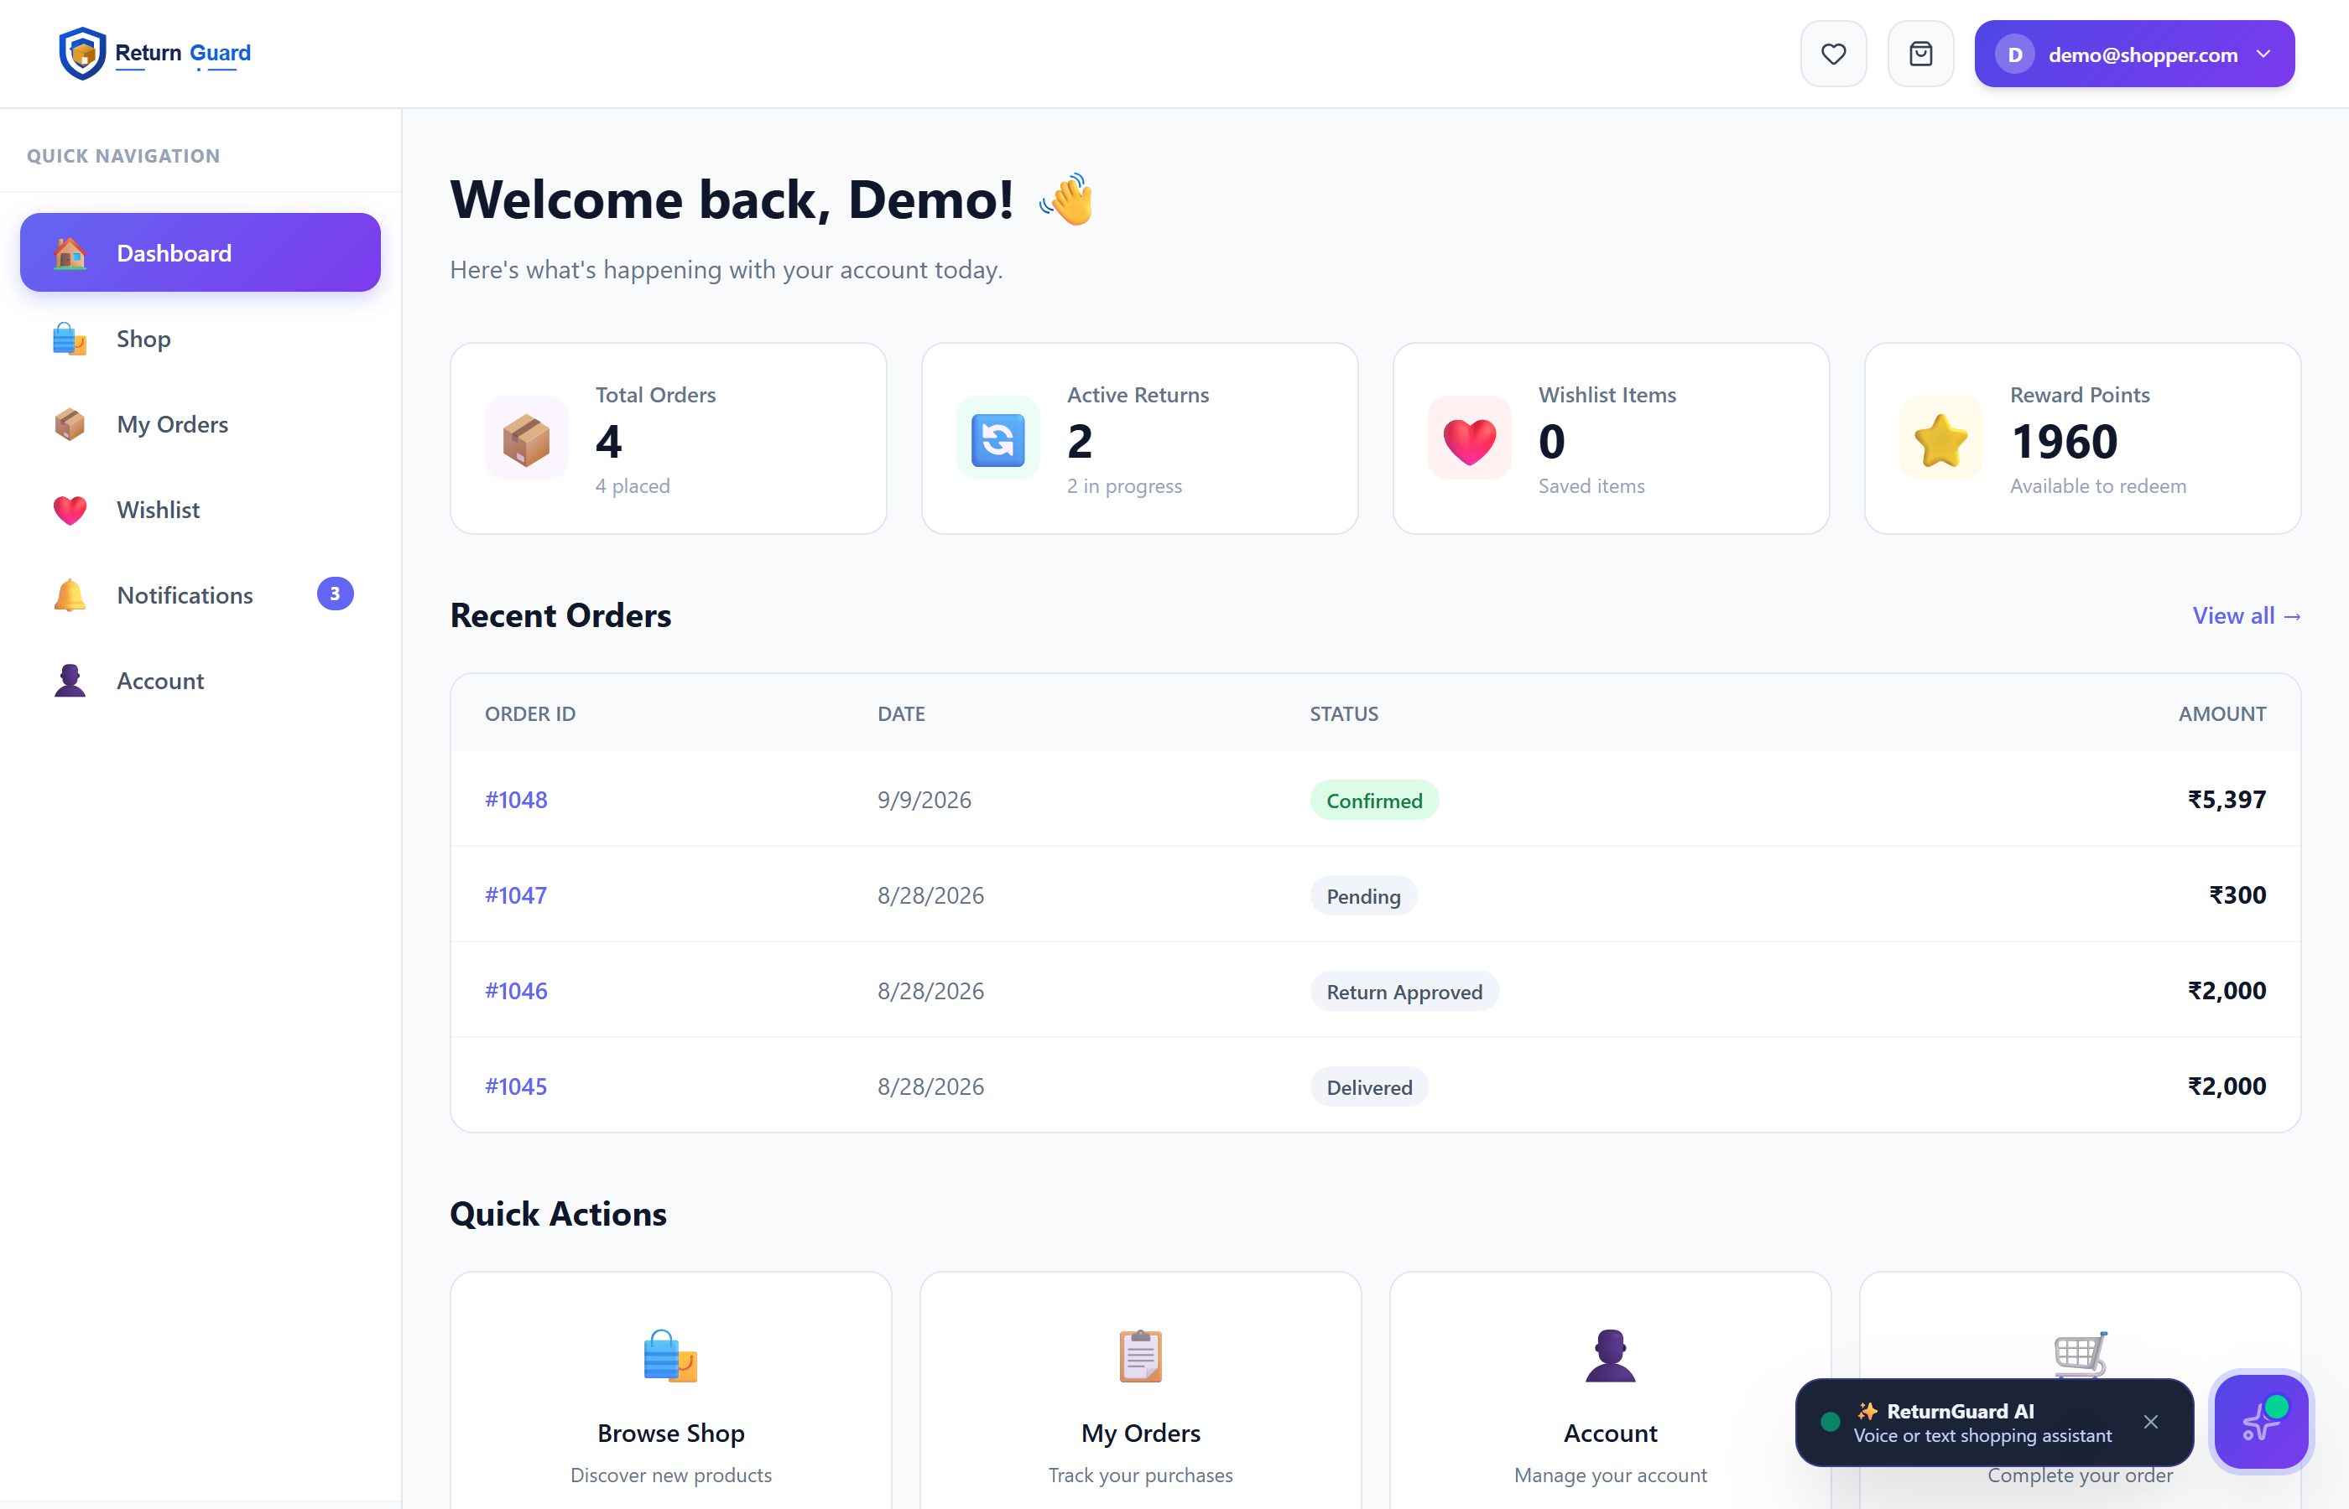
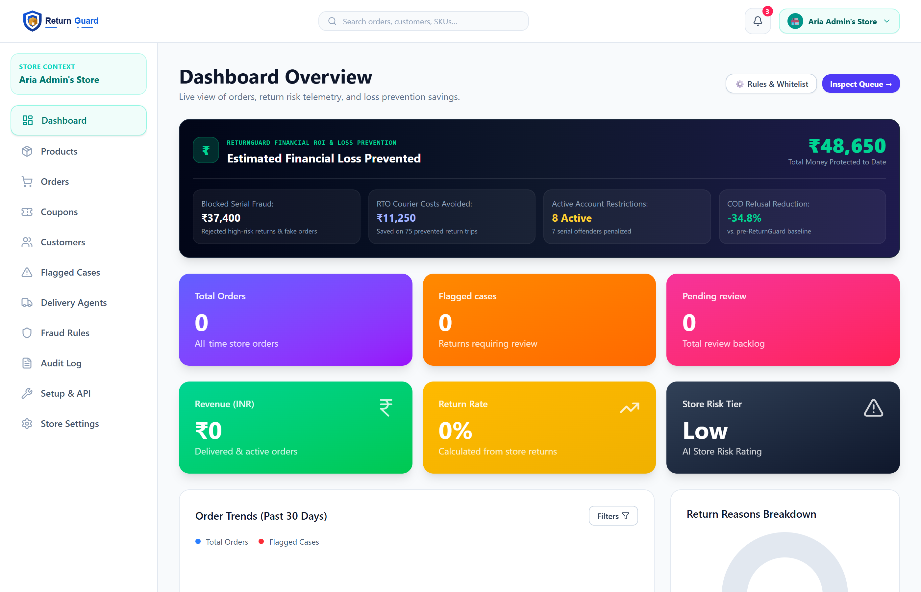
SHOPPER & MERCHANT DASHBOARDS
Shopper Portal: Order History, Reward Points & 1-Click Return/Exchange Hub
Merchant Portal: Executive Risk KPIs, Flagged Returns Queue & Fraud Triage
SHOPPER STOREFRONT & SELF-SERVICE PORTAL
• 1-Click Return Initiation: Seamless self-service return and exchange flow directly from customer order history with dynamic reason collection.
• Smart Exchange Incentive: Prompts instant size/color exchanges over cash refunds, reducing reverse freight fees while preserving the sale.
• Live Order & Return Tracking: Transparent real-time status tracking showing pickup scheduling, doorstep verification, and refund timeline.
• Friction-Free Experience: 85%+ of genuine shoppers enjoy instant auto-approval with zero administrative hurdles or hold times.
MERCHANT OPERATIONS COMMAND CENTER
• Executive KPI Intelligence: Real-time visibility into overall return rates, prevented loss values, risk tier breakdown, and order velocity.
• Automated Anomaly Triage: Continuous 0–100 risk scoring automatically funneling suspicious claims into a prioritized review queue.
• Configurable Fraud Policies: Dynamic sliders to tune sensitivity per category, seasonal festive wardrobing rules, and serial tracking.
• Custody Chain & Logistics: Integrates doorstep digital witnessing, courier handover verification, and driver collusion tracking.

Slide 4
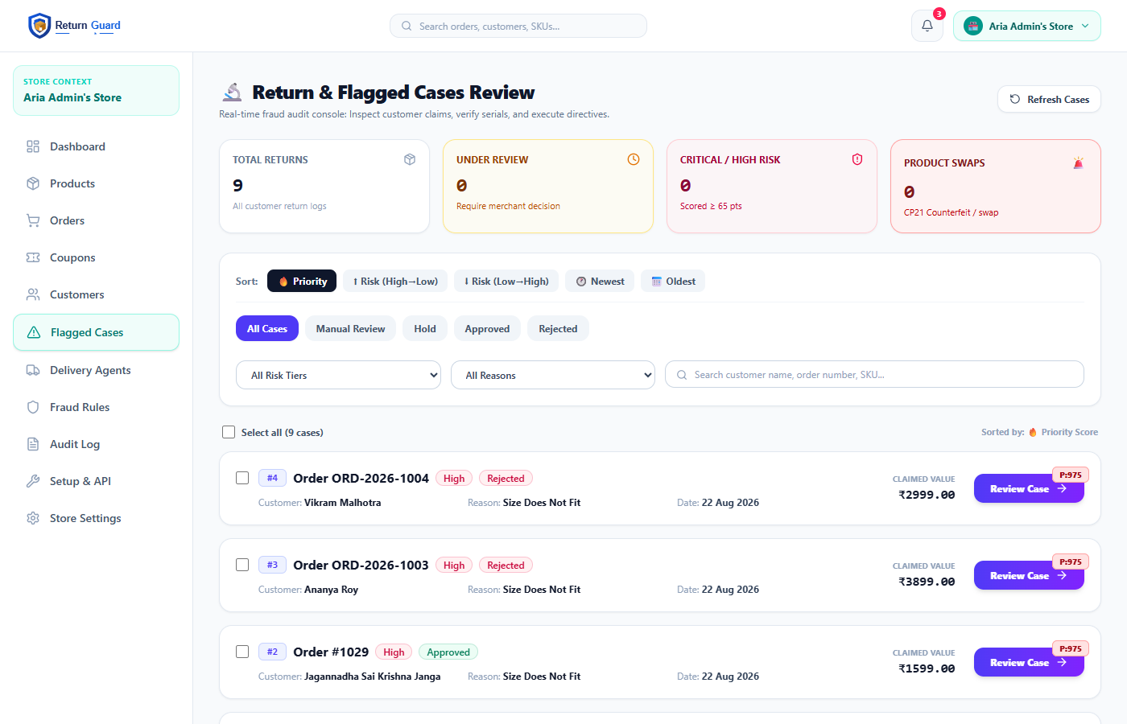
CHALLENGES & SOLUTIONS
• Challenge 1 — Wardrobing & Festive Rental Abuse: Shoppers buy premium ethnic apparel for Diwali or wedding seasons, wear them once, and return for full refunds. Solution (CP4): Seasonal cultural risk tightening, mandatory tag-intact verification, and pre-return condition checks.
• Challenge 2 — Size Bracketing Multi-Orders: Buyers purchase 3–4 sizes of the same SKU intending to keep only one, inflating freight costs by 300%. Solution (CP10): Cart-level multi-size detection with instant size exchange incentives over cash returns.
• Challenge 3 — Electronics Hardware Swapping: High-value electronics returned with missing chargers, clone units, or dummy ballast weights. Solution (CP17): Strict outbound vs inbound serial/IMEI verification with automated +50 pt critical risk flagging.
• Challenge 4 — Courier & Driver Collusion: Delivery drivers falsely marking items as 'customer rejected' or siphoning returned goods during transit. Solution (CP24): Geo-stamped doorstep signatures, tamper-evident seals, and driver route anomaly analytics.
Live Screen: Flagged Cases Queue (Actionable Risk Scoring & Resolution Workflow)

Slide 5
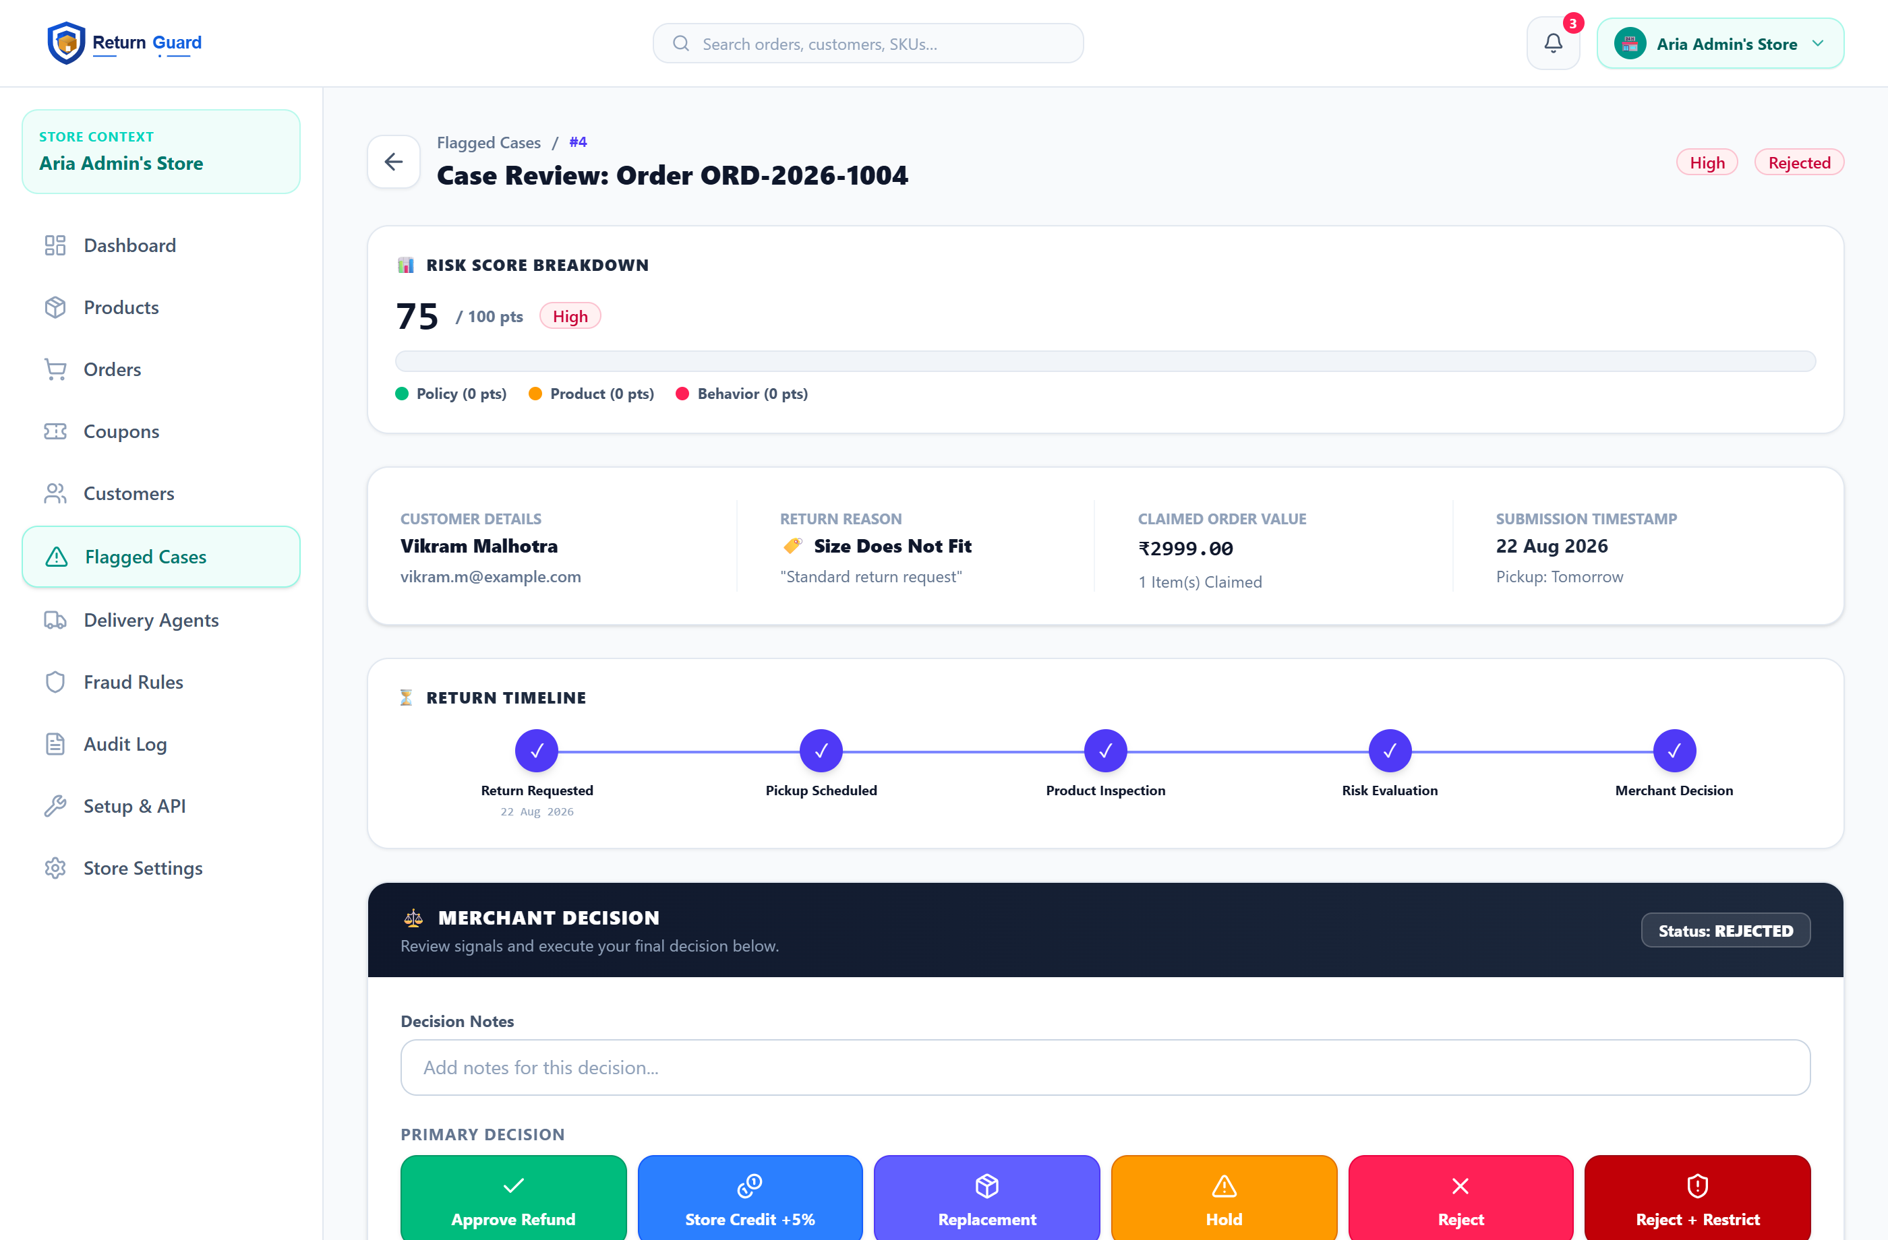
KEY FEATURES
• Customer & Risk Profile Context: Real-time shopper telemetry displaying customer identity, order history, active return rate, and flagged risk tier (High Risk • 78 pts).
• 5-Step Return & Risk Engine: Automated lifecycle progression through Return Requested → Pickup Scheduled → Product Inspection → Risk Evaluation → Merchant Decision.
• 1-Click Merchant Decision Panel: Direct operational execution buttons: Approve Refund (Green), Store Credit +5% (Blue), Replacement (Indigo), Hold (Amber), Reject (Rose), or Reject + Restrict (Dark Red).
• 4-Tier / 28 Risk Checkpoints: Comprehensive evaluation pipeline covering Pre-Scoring Gates, Physical Attributes, Behavioral Biometrics, and Composite Decision Rules.
• 6-Level Escalation Ladder: Proportionate customer friction scaling from instant auto-approval to OTP challenge, COD lock, and account termination.
• Full Audit & Case Documentation: Structured decision notes capture and immutable audit logging for fraud disputes and chargeback defense.
Live Screen: Flagged Case Review (Customer Profile, 5-Step Return Engine & Decision Panel)

Slide 6
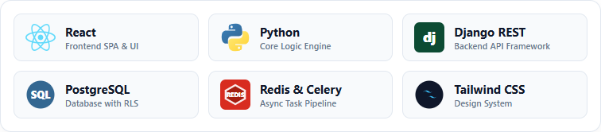
TECHNOLOGY STACK
FRONTEND & CLIENT ARCHITECTURE
• React & Vite SPA: Modular component architecture powering both shopper store and merchant command center with hot module replacement.
• Tailwind CSS Design System: Utility-first design delivering responsive layouts, risk badges, and accessible data tables.
• Lucide React Icons & Context API: Clean icon set with lightweight global state management for auth, cart, and live alerts.
• Resilient API Client: Axios HTTP layer featuring automatic JWT token refreshing and error boundary fallback states.
BACKEND, DATABASE & TASK PIPELINE
• Python & Django REST Framework: Robust RESTful API architecture running 28-checkpoint scoring with sub-second execution.
• PostgreSQL with Row-Level Security: Relational database with strict tenant isolation, foreign keys, and ACID compliance.
• Redis & Celery Worker Queue: Distributed asynchronous background pipeline handling risk scoring and automated alerts.
• Security & Invoicing Engine: HMAC SHA-256 webhook signatures, encrypted telemetry, and ReportLab PDF invoice generation.

Slide 7
CONCLUSION
CORE SYSTEM DELIVERABLES
• Complete Working Platform: Dual-portal e-commerce application integrating a customer storefront with a real-time merchant operations command portal.
• 28 Algorithmic Checkpoints: Comprehensive multi-tier scoring pipeline analyzing behavioral, cultural, physical, and logistics checks.
• 6-Level Escalation Ladder: Dynamic, proportional friction scaling from automated approval to doorstep OTP, COD restriction, and blacklisting.
• Production API Architecture: Scalable Django REST backend with asynchronous task workers and PostgreSQL Row-Level Security isolation.
• Full Audit & Case History: Immutable tracking logs capturing every risk signal, customer action, and merchant resolution.
BUSINESS VALUE & QUANTIFIED IMPACT
• 85%+ Instant Approvals: Genuine customers experience zero friction with instant auto-approval on legitimate orders and return claims.
• 70% Cut in Wardrobing Abuse: Cultural and seasonal calendar rules eliminate organized festive garment rental fraud during weddings and festivals.
• Reverse Freight Recovery: Eliminates unnecessary 3x forward logistics fees on abusive multi-size orders and merchandise swapping.
• Protects Merchant Margin: Empowers small-to-mid Indian D2C retailers to offer safe COD payments without risking inventory bankruptcy.
• Granular Policy Customization: Store operators can adjust risk sensitivity sliders dynamically per product category to optimize margins.

Slide 8
FUTURE SCOPE
1. MOBILE EDGE COMPUTER VISION
• Real-Time Doorstep Scanning: Deploy lightweight on-device AI vision models to couriers' handheld devices for real-time fabric texture analysis, tag integrity verification, and wear detection prior to acceptance.
2. CONSORTIUM FRAUD GRAPH NETWORK
• Cross-Merchant Identity Mesh: Privacy-preserving zero-knowledge graph network that pools anonymized risk telemetry across independent Indian D2C stores to preemptively flag serial fraudsters.
3. MANIFEST V3 CHROME OPERATIONS EXTENSION
• Embedded E-Commerce Integration: Browser toolbar extension injecting ReturnGuard's 0-100 risk badges and 1-click triage buttons directly inside Shopify, WooCommerce, and Magento order management panels.
4. AUTOMATED UPI PENNY-DROP & SPLIT REFUNDS
• Frictionless Micro-Settlements: Algorithmic bank account verification via ₹1 NPCI UPI penny-drops, enabling automated fractional payouts and dynamic deductions for missing product accessories or tags.

Slide 9
THANK YOU
ReturnGuard: AI-Assisted Return-Fraud Detection Platform
Open for Questions, Architectural Inquiries & Technical Discussion

